Slide 1




AUTOMATION PROJECT
-N Lakshmi Deepak

Slide 2


PERSONAL BACKGROUND
NAME : N LAKSHMI DEEPAK
QUALIFICATION : B-TECH
BRANCH : ECE
EXPERIENCE : FRESHER
GIT : https://github.com/Lakshmideepak1806/MyCapstoneProject

Slide 3
Problem Statement of the Capstone Project:
Overview: The goal of this project is to automate key functionalities and processes on the NOPCommerce demo website (https://demo.nopcommerce.com/). NOPCommerce is an open-source eCommerce solution, and this demo site is frequently used to showcase the platform’s capabilities. Manual testing of the demo.nopcommerce e-commerce website is time-consuming and prone to errors, especially with frequent updates and feature changes. The project aims to automate key functionalities like user registration, login, product search, add to cart, and checkout using Java and Selenium Web Driver. Automation helps improve test accuracy, reduce testing time, and ensure consistent validation across multiple test cycles. The challenge includes handling dynamic elements, implementing waits, managing test data, and generating reports to support efficient and reliable testing.
Objective: To automate the critical features of the NOPCommerce demo website to ensure comprehensive testing and efficient operation. The automation will cover:
Functional Tests: Automated checks for user registeration, login, product search, cart functionality, checkout process, and order placement.
Cross-Browser Testing: Ensure the website performs consistently across different browsers (Chrome, Firefox, Edge, Safari).
Load Testing: Automate performance tests to assess how the website handles multiple concurrent users and transactions.
Proposed Automation Tools and Technologies:
Selenium (for web automation).
TestNG (for test management and reporting).

Slide 4
Challenges in Manual Testing:
Takes a Lot of Time: Manually repeating tests This becomes especially time-consuming when testing multiple scenarios after every update.
Human Mistakes: Testers may accidentally skip steps or enter incorrect data. This can lead to inaccurate results and missed bugs.
Hard to Keep Track: As more features are added, updating a growing number of test cases becomes difficult. This can result in overlooked or incomplete tests.
Challenges in Automation (Using Selenium and TestNG):
Dealing with Changing Elements: Web elements (buttons, product listings, etc.) often change dynamically. Writing flexible scripts that work despite these changes is tricky.
Waiting for Things to Load: Automation scripts need to wait for elements to load before interacting. If done incorrectly, tests may fail due to slow loading times.
Managing Test Data: Test data must be well-organized, especially when testing with multiple users or products. Keeping this data accurate is challenging.
Testing on Different Browsers: The website must work across multiple browsers (Chrome, Firefox, etc.).
Generating Reports: After running automated tests, generating clear and comprehensive reports is essential. Customizing these reports to show useful insights requires additional effort.

Slide 5
JIRA
Jira is a powerful project and test management tool we used to manage our nopCommerce project effectively. It helped us organize user stories, track progress, execute test cases, and ensure timely sprint delivery.
Key Areas of Usage:
1. Sprint Management
We created and tracked NOP Sprint 1 (8–22 Sep) with 22 user stories.Each story was mapped to specific modules (e.g., Login Page, Register Page).The sprint was successfully completed with all stories marked Done. Provided real-time status updates: To Do, In Progress, Done, Passed, Failed. Helped in smooth sprint review and closure.
2. Backlog & User Stories
Well-structured user stories were maintained in the backlog.Each story included clear acceptance criteria.Stories were categorized by page/module (e.g., "As a user, I should be able to log in...").
3. Test Case Management with Zephyr
Used Zephyr plugin for managing and executing test cases.
Example: TC_SEARCH_042 tested result page navigation and was marked PASS.
Benefits Observed:
Streamlined workflow from requirement gathering to testing.
Centralized system for all team members.
Increased transparency, traceability, and efficiency.

Slide 6
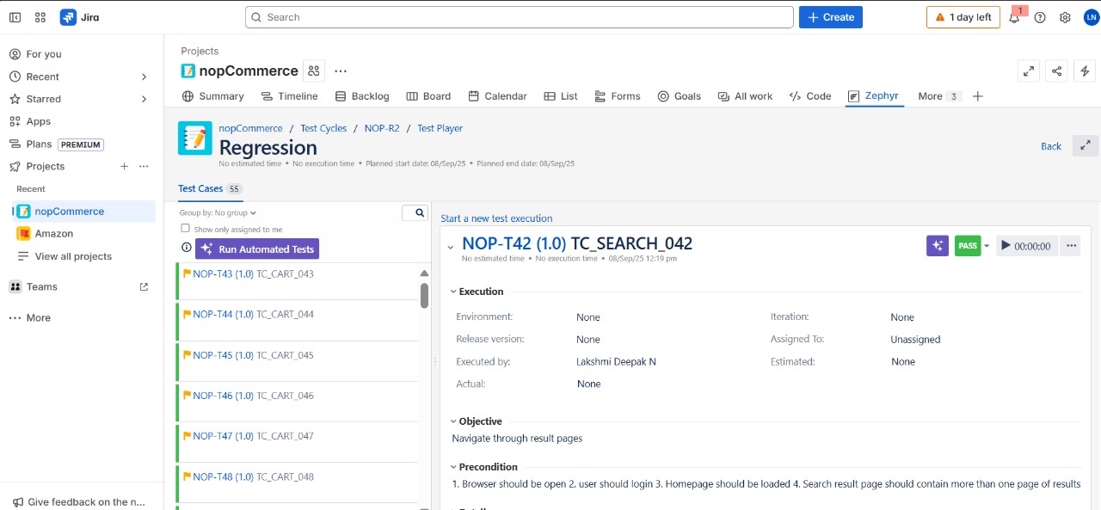

Slide 7
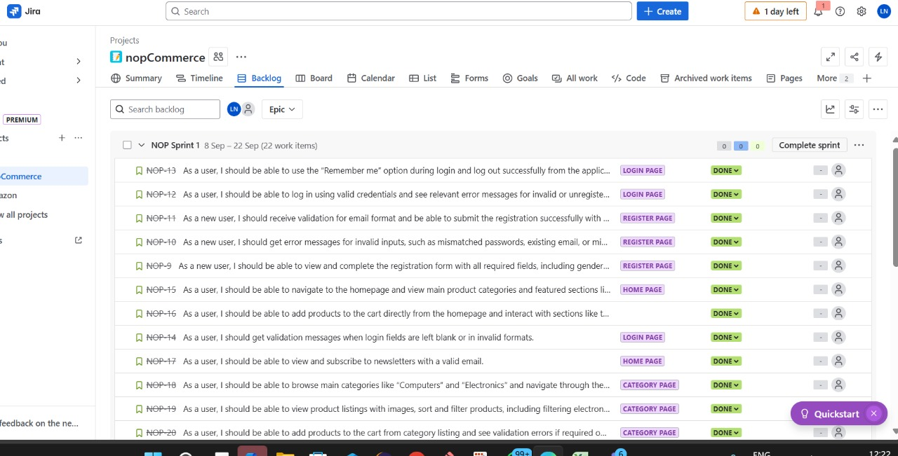
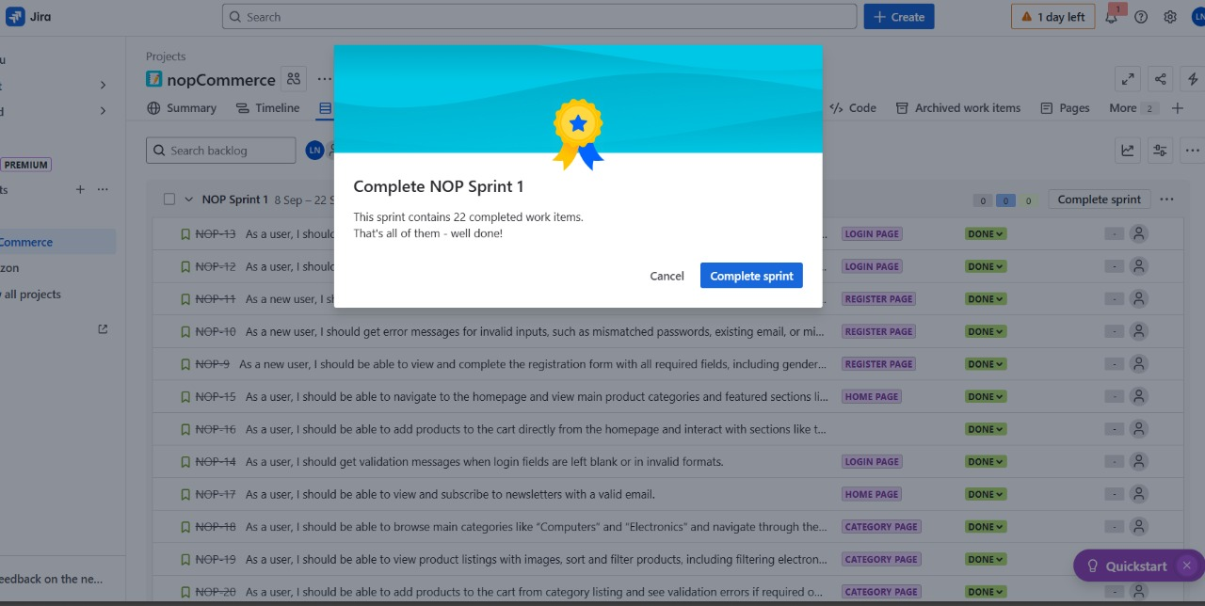

Slide 8
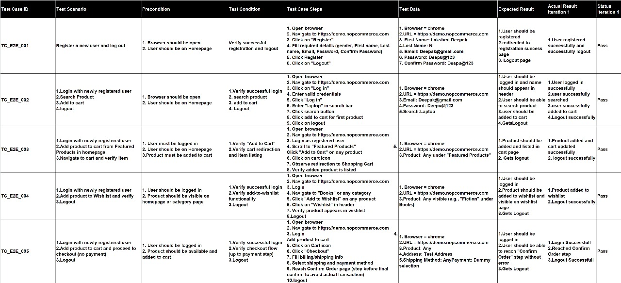
Manual Test Cases for End To End Test Cases

Slide 9
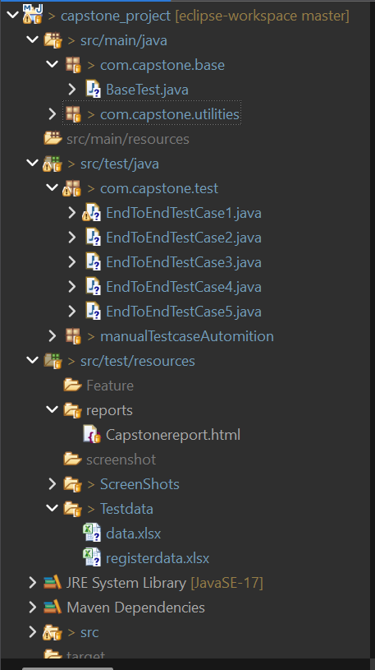
Project Structure
src/main/java
➡ Framework code (base classes, utilities)
BaseTest.java: Sets up and closes the browser, used by all test cases.
utilities: Extra helper code like reading Excel files or taking screenshots.
src/test/java
➡ Actual test cases
EndToEndTestCase1.java to EndToEndTestCase5.java: Automated test scripts for testing your application.
Manual Test case Automition : contain tests converted from manual test cases. (Note: Spelling should be "Automation")
src/test/resources
➡ Supporting files
reports/Capstonereport.html: Test report after running tests.
Screen Shots: Stores screenshots of failed tests.
Test data: Excel files with test input data (data.xlsx, registerdata.xlsx).

Slide 10
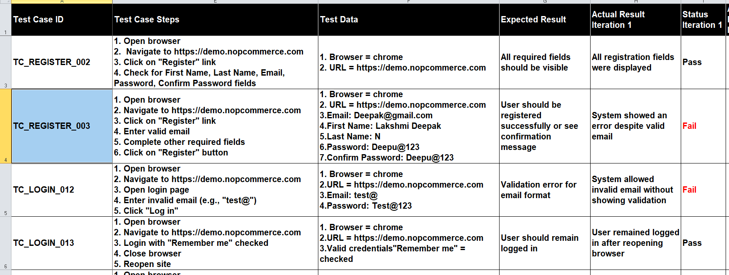
Manual Defect Reports
Defect Id. | Module name | Defect Summary | Defect Description | Defect Category | Detected in Browser | Environment | Defect Severity
DF_Register_002 | Register | Valid email address not accepted in registration | When a valid email is entered in the registration form, the system throws an error message stating the email is invalid. This prevents users from registering successfully even when the email is formatted correctly. Steps To Reproduce the Bug: 1. Open browser 2. Navigate to: https://demo.nopcommerce.com 3. Click on "Register" 4. Enter valid email like: Deepak@gmail.com 5. Fill all other valid fields 6. Click on "Register" Expected Result: User should be registered successfully Actual Result: Error message shown for valid email | Coding | Google Chrome | Internal Dev | High
DF_Login_016 | Login | Email field accepts invalid email format during login | When an invalid email (e.g., test@) is entered in the login form, the system does not display a validation message. Instead, it proceeds to attempt login. This behavior fails to enforce proper front-end validation. Steps To Reproduce the Bug: 1. Open browser 2. Navigate to https://demo.nopcommerce.com 3. Click on "Login" 4. Enter email: test@ 5. Enter password: Test@123 6. Click on "Login" Expected Result:Validation message should appear: "Wrong email" Actual Result:No validation message shown | Validation | Google Chrome | Internal Dev | Medium

Slide 11
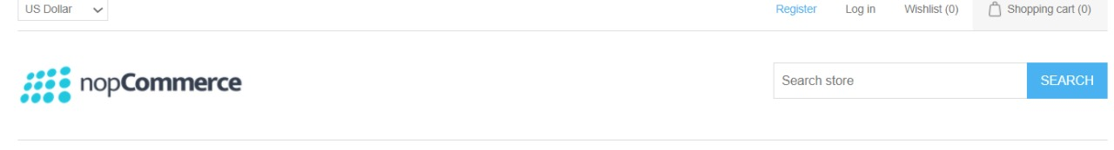
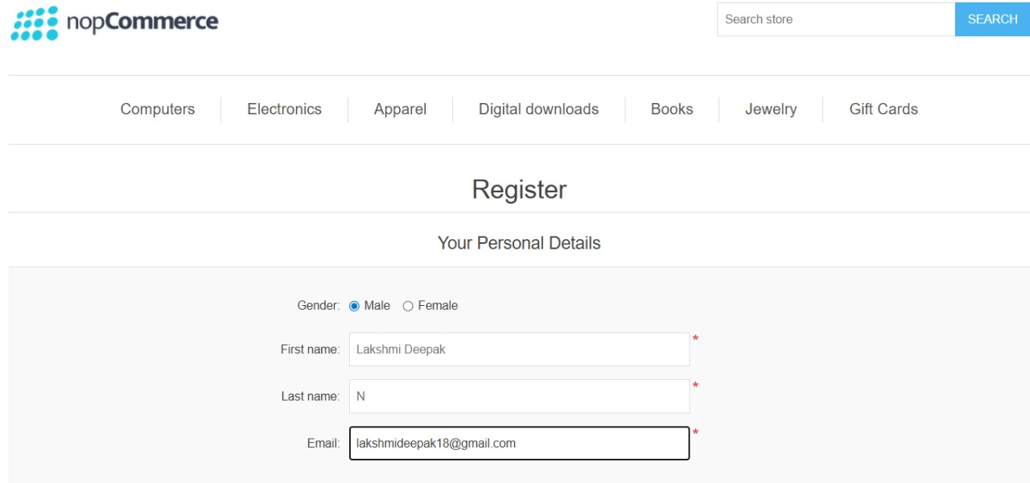
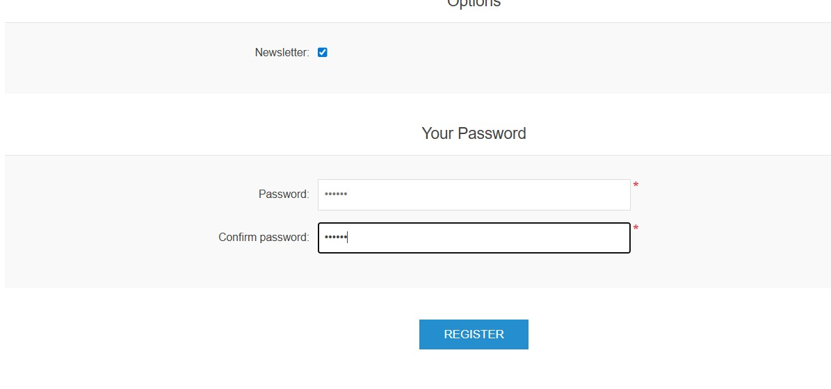
Selenium Automation Test Case 1

Slide 12
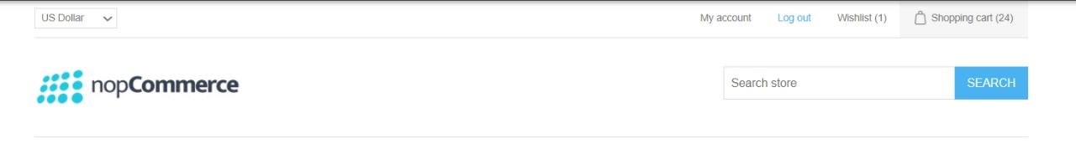
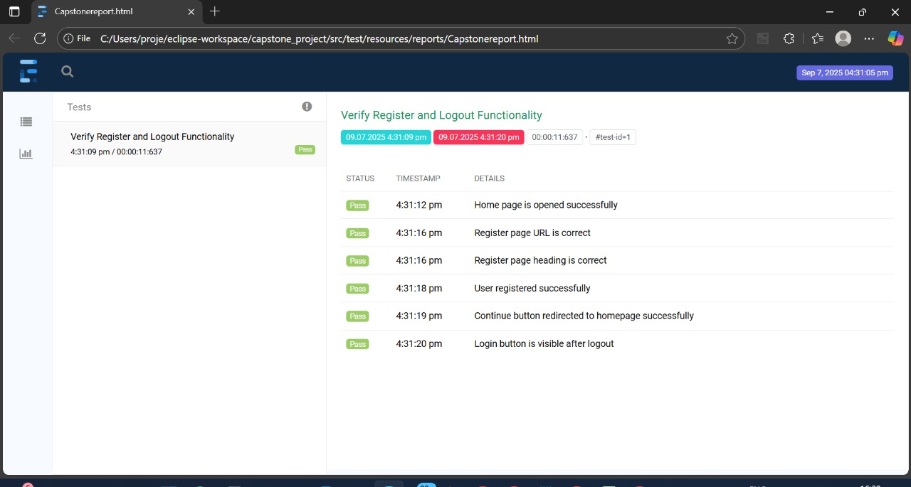
Generated Reports

Slide 13
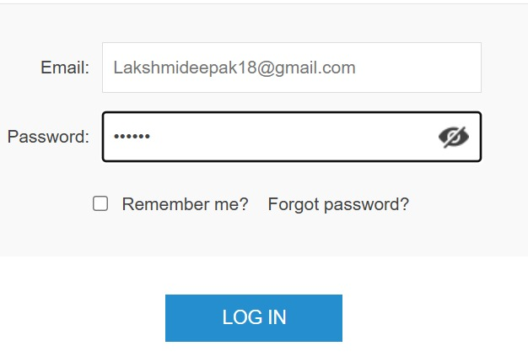
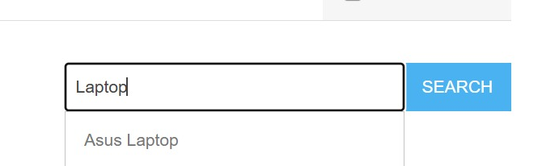
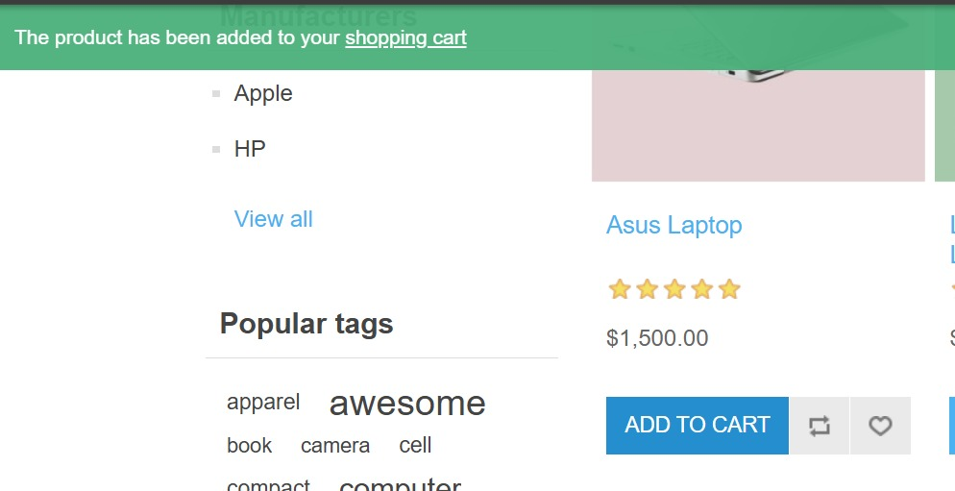
Selenium Automation Test Case 2

Slide 14
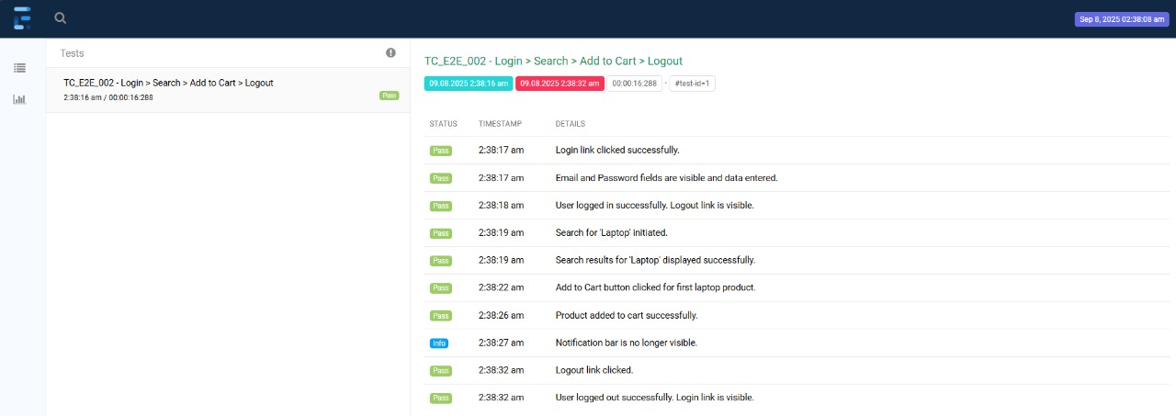
Generated Reports

Slide 15
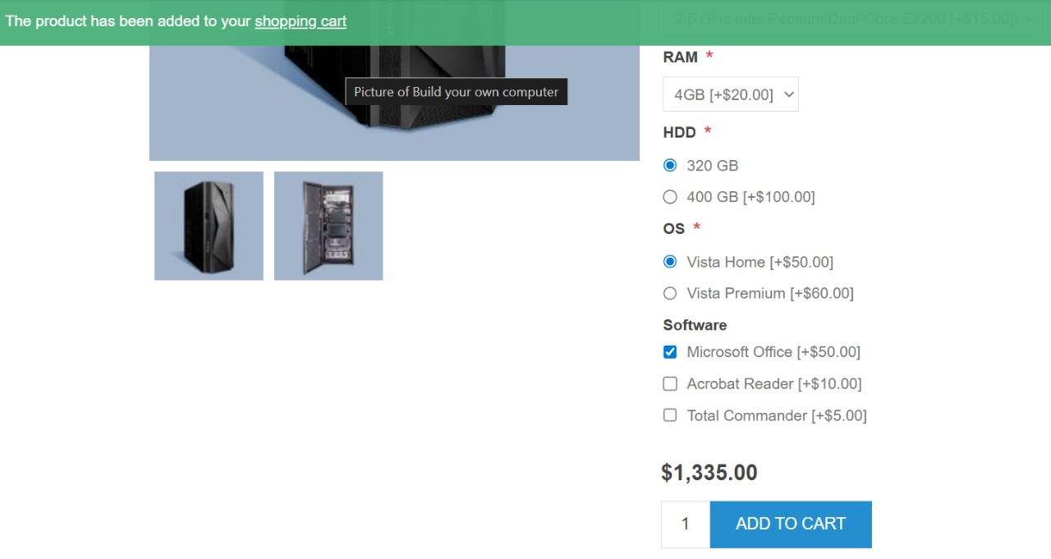
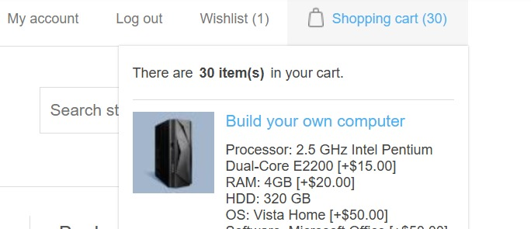
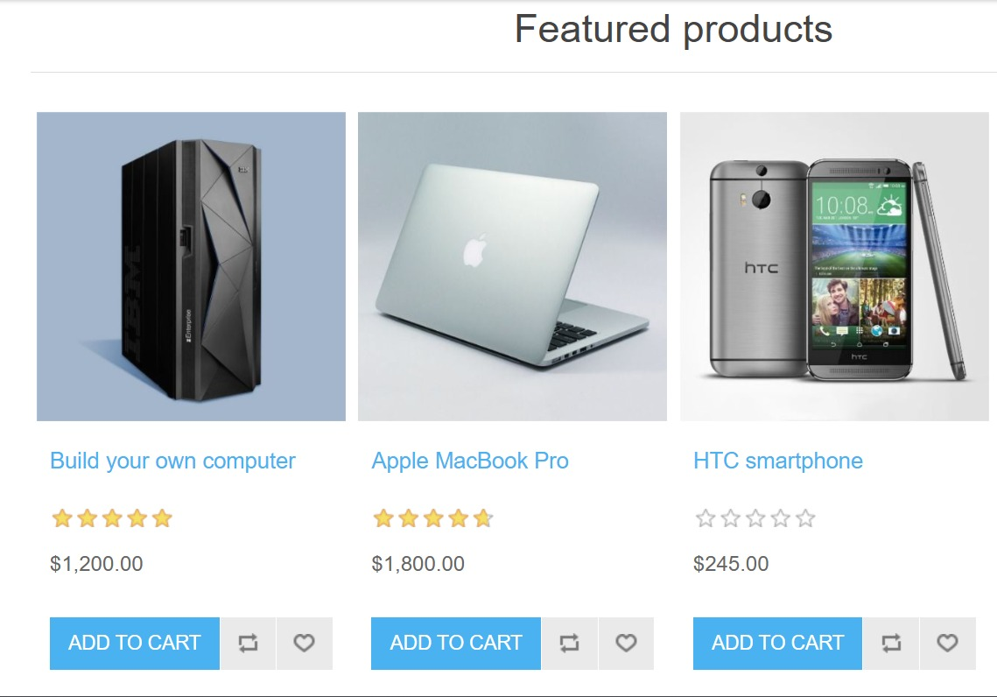
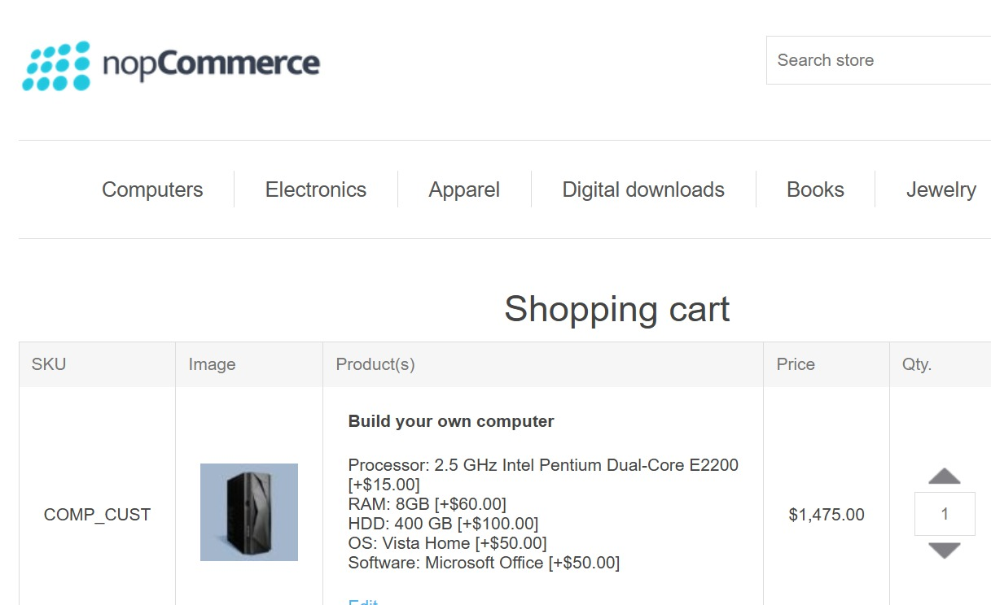
Selenium Automation Test Case 3

Slide 16
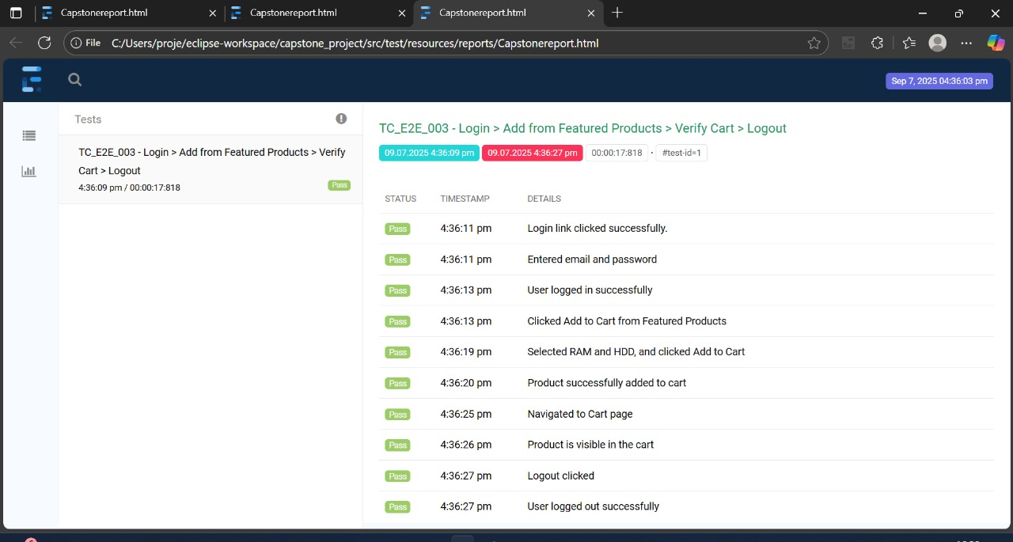
Generated Reports

Slide 17
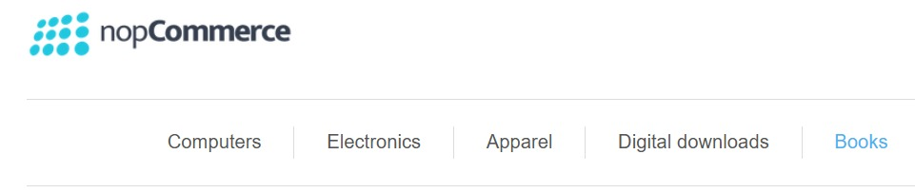
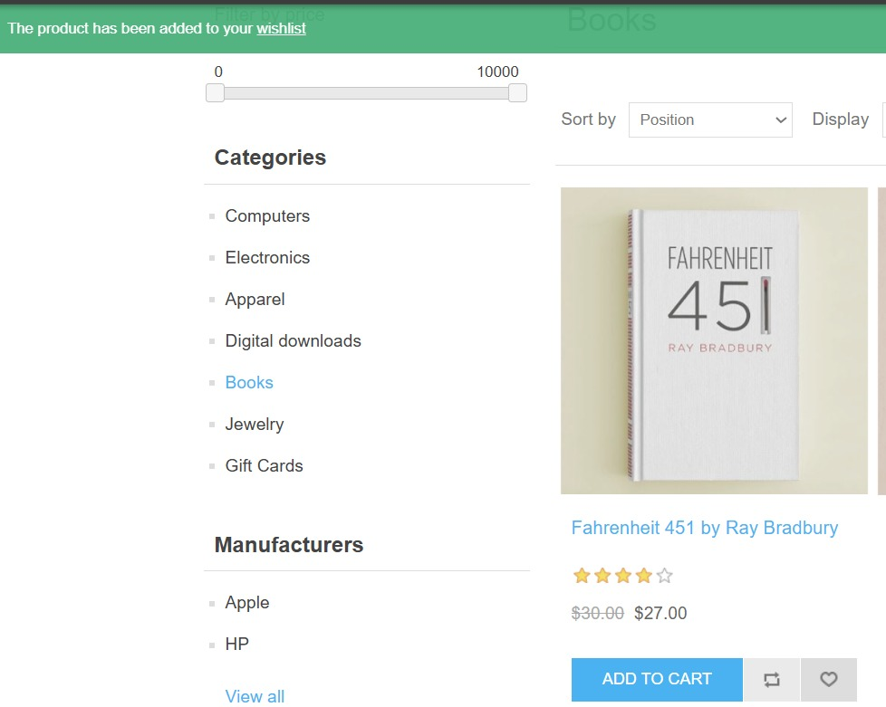
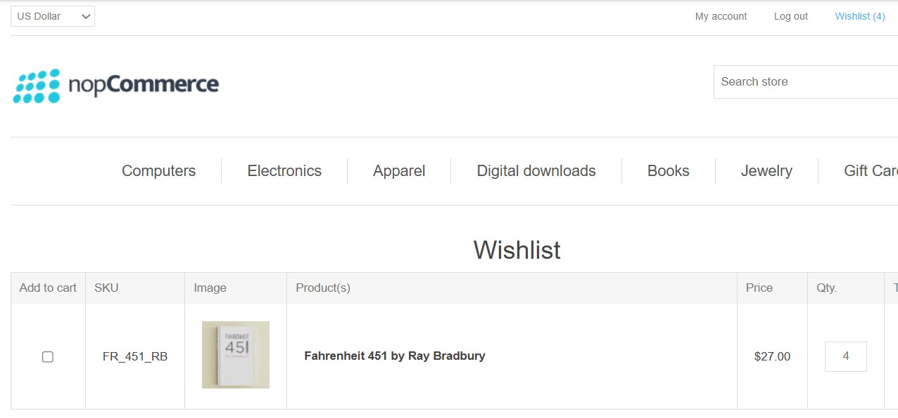
Selenium AutomationTest Case 4

Slide 18
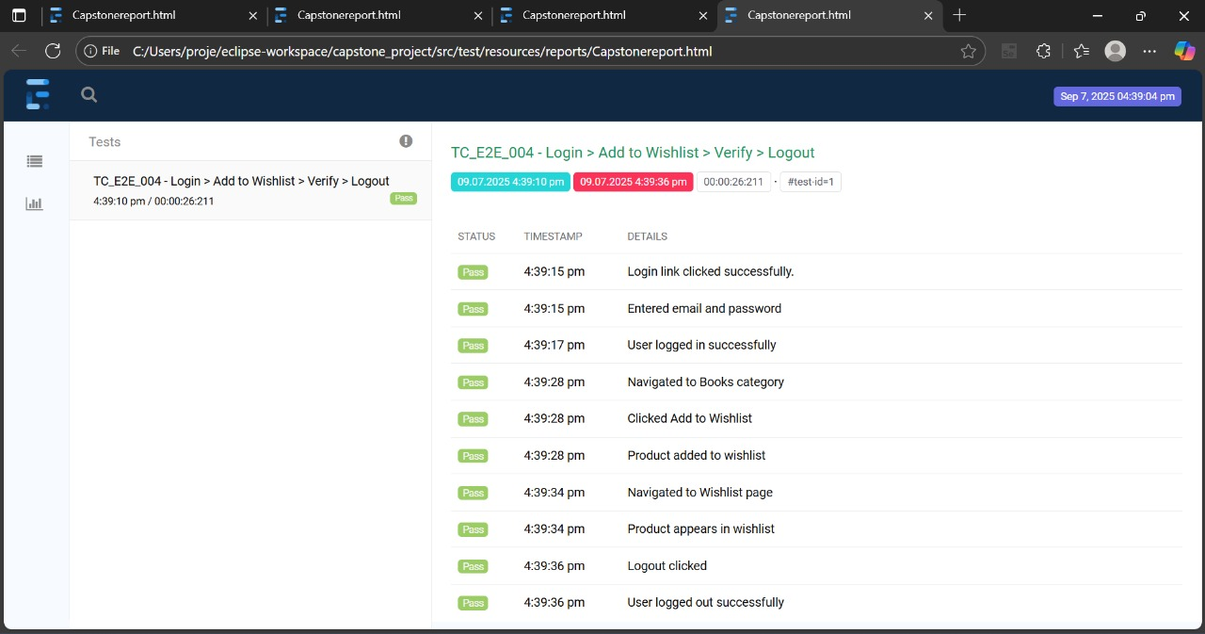
Generated Reports

Slide 19
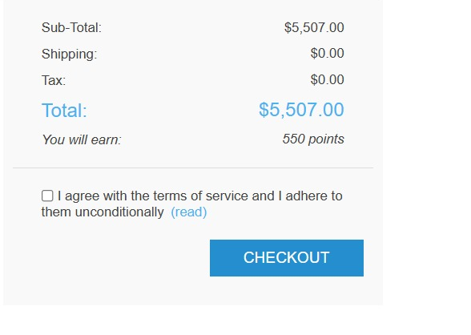
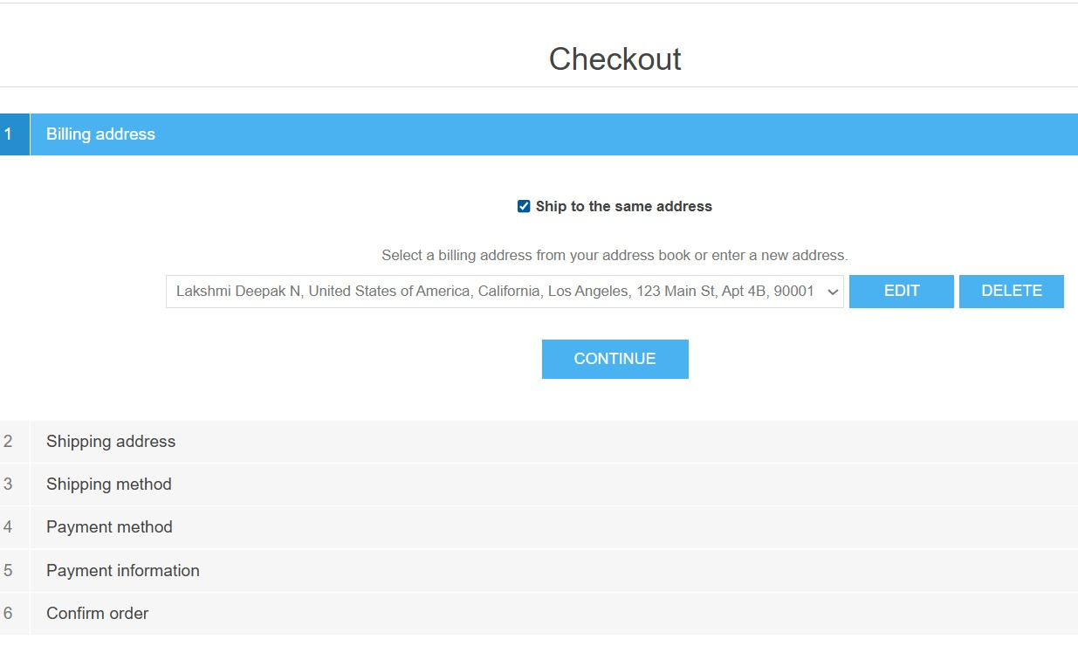
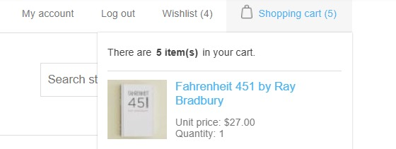
Selenium Automation Test Case 5

Slide 20
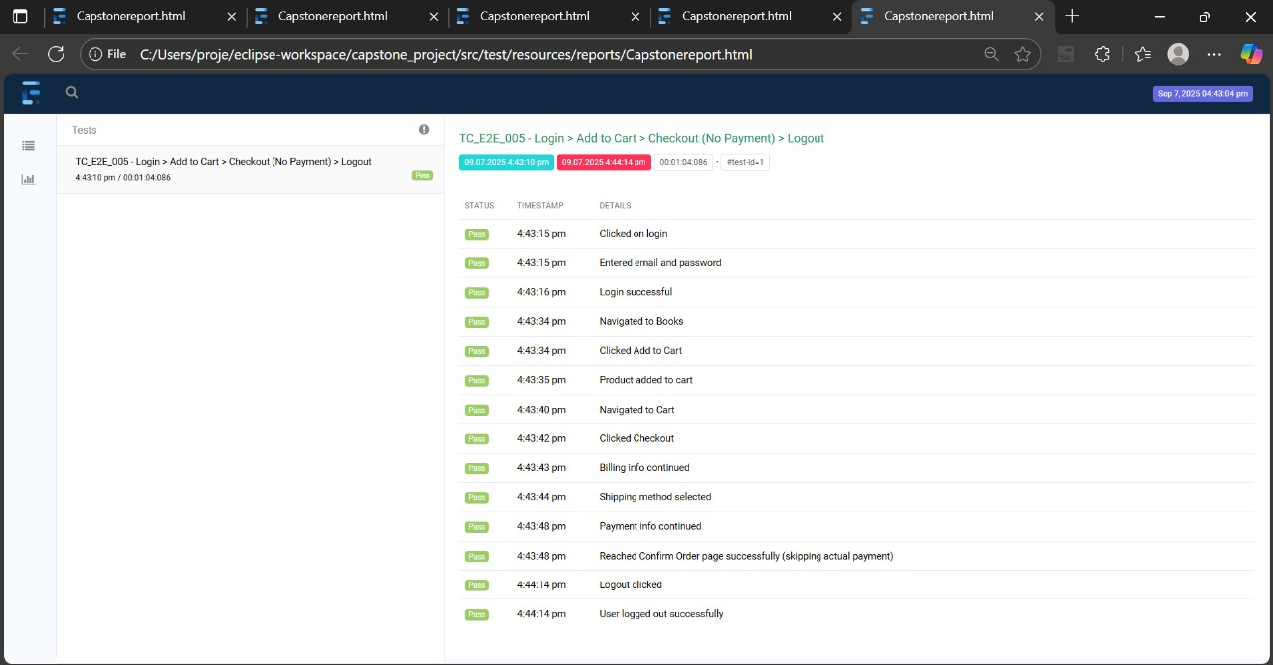
Generated Reports

Slide 21
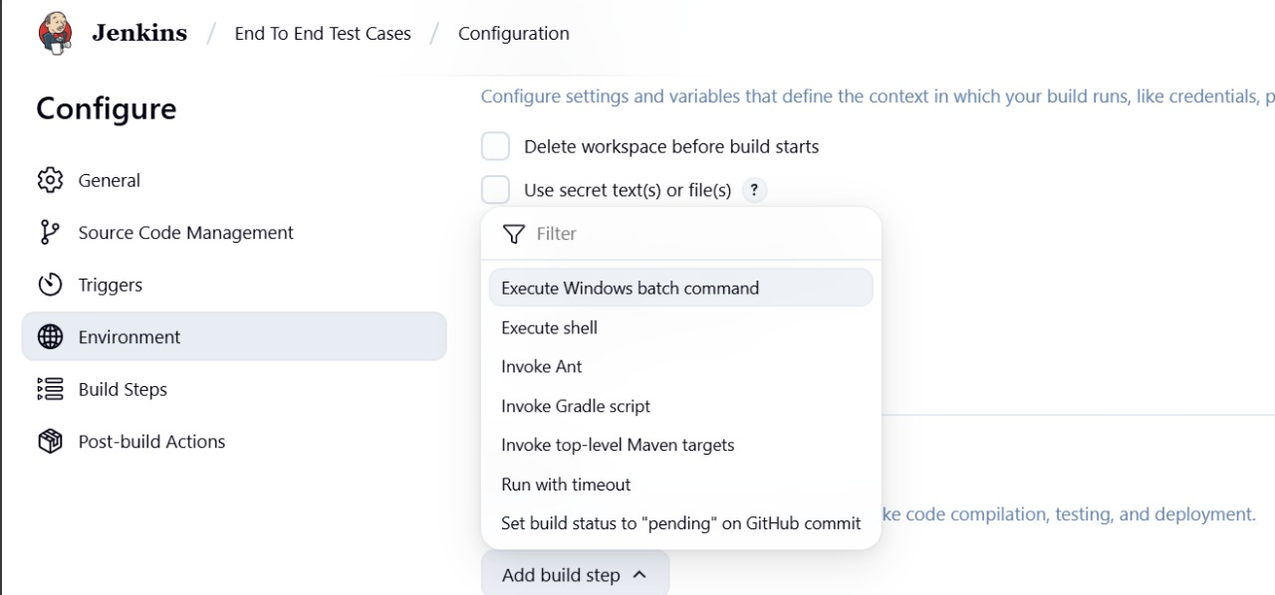
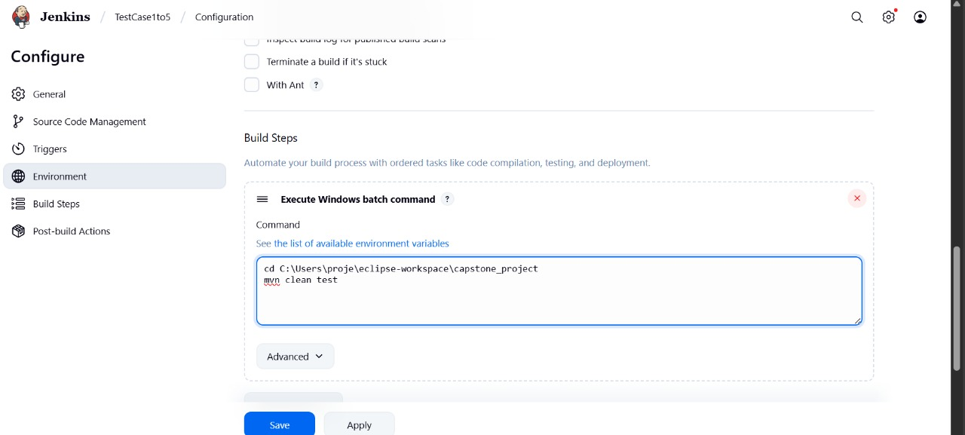
Jenkins
Jenkins Overview:
Jenkins is an open-source automation server used to automate
building, testing, and deploying software projects.
Create a New Job
Click “New Item”
Enter job name (e.g., End To End Test Cases)
Select “Freestyle project”
Click OK
Add Build Step
Scroll to Build Steps
Click “Add build step” → “Execute Windows batch command”
Add the following commands:
cd C:\Users\proje\eclipse-workspace\capstone_project
mvn clean test
Click on run

Slide 22
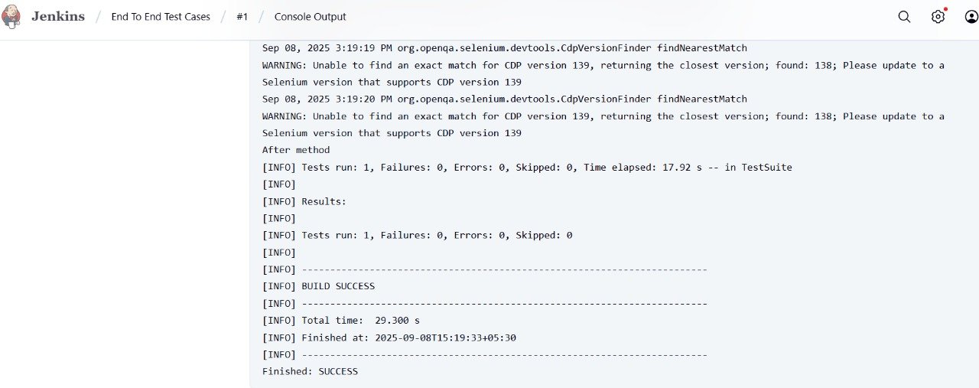
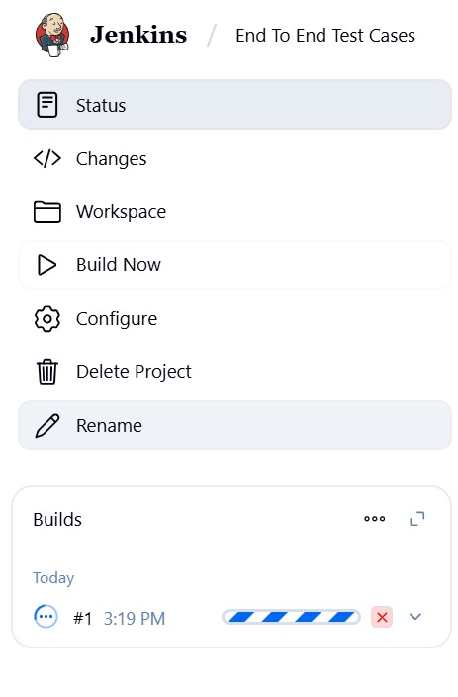

Slide 23
Conclusion
This project successfully automated essential features of the NOPCommerce demo website using Selenium WebDriver and TestNG, covering actions such as user registration, login, product search, adding items to the cart, and the checkout process.
Key achievements include:
Efficient Test Execution: Automation reduced the time needed for repetitive tasks, and TestNG provided structured test management and detailed reporting, helping to identify issues early.
Comprehensive Test Coverage: The test suite covered key scenarios, ensuring consistent functionality across browsers like Chrome, Firefox, and Safari.
Scalability & Reusability: The automation framework is scalable, allowing for easy additions of new test cases. The use of Excel for data management enhanced the efficiency of data-driven testing.
Accurate Results: Automated tests provided reliable, consistent results with minimal errors, while TestNG reports made it easy to track and resolve issues.
Improved Quality Assurance: Automation ensured continuous testing of critical actions, contributing to the overall quality assurance process.
In conclusion, automation with Selenium WebDriver and TestNG improved the efficiency, accuracy, and scalability of testing for the NOPCommerce demo website. This approach reduced testing time and maintained high-quality standards, ensuring consistent validation as the website evolves.

Slide 24
Thank You

